Slide 1
Library Management System
Santosh Tamang
Anoj Aryal
Baibhav Poudel
Krishal Pudasaini
Praveen Kumar Labh

Slide 2
Introduction
The system provides access to library collections through a user-friendly interface. An LMS can be used by both librarian staff and students to search for and locate materials, track borrowing activity, and manage library resources.

Slide 3
Root Description
The University Of Bedfordshire have a library which allows students to read/borrow books or use an available workstation by providing the proper information to find the correct book shelf with the row or a workstation.

Slide 4
User Centered Design(UCD)
Moto – “User Front and Center”
Who my users are?
How will they be accessing my product?
Are differently-abled users able to the producd?

Slide 5
Requirement Gathering
Brainstorming
Asking the end-users
Asking the client
Asking the shareholders

Slide 6
Functional Requirement
See available books
Search for the book(book’s name, author's name), empty workstation
Provide information about the exact location of the book, empty workstation
Provide the details of the searched book
Borrow book
Admin: Add books/workstation, View books, Lend books

Slide 7
Non-Functional Requirements
Easy Navigation
As Fast As Possible
Provide Correct Information
Support Future Amendment
Multilingual

Slide 8
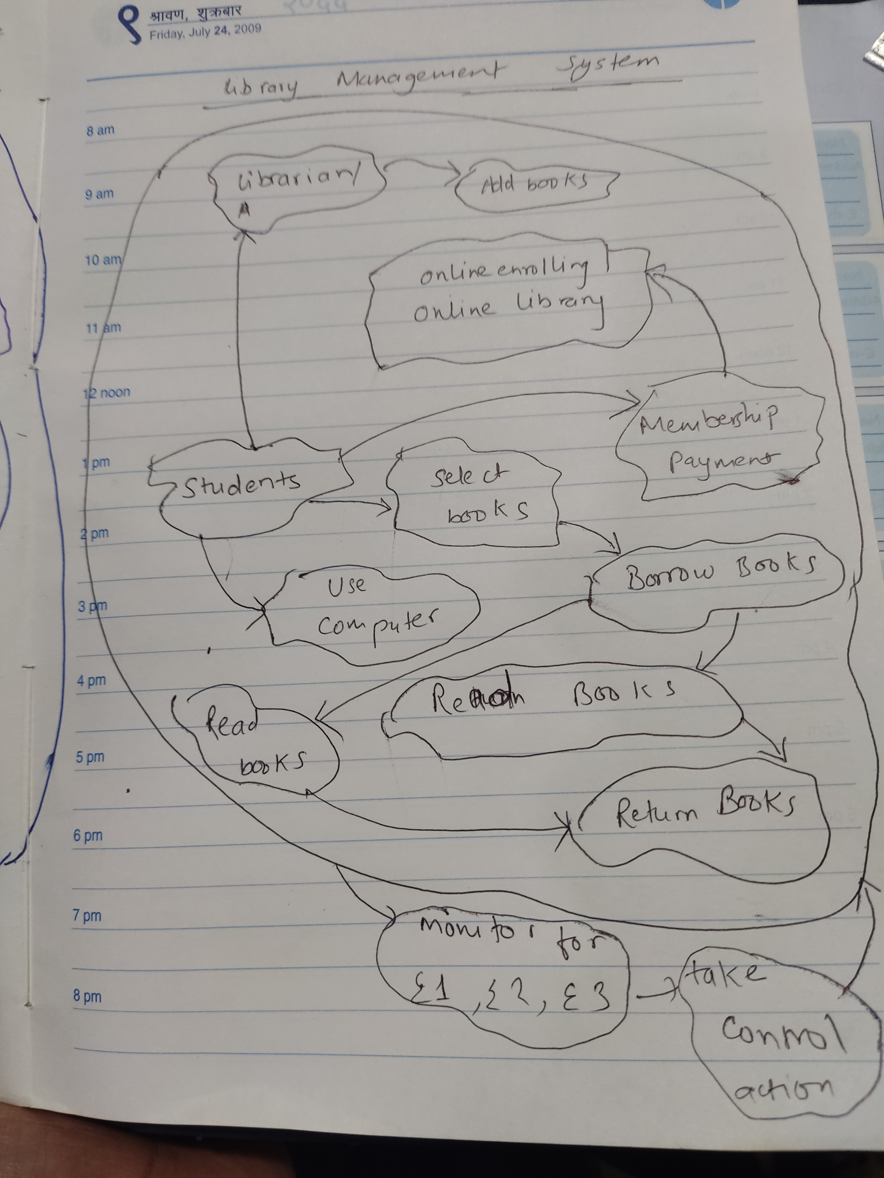
Conceptual Model

Slide 9
CATWOE
C – Students
A – Librarians, Library Administration, University Administration
T – Shelves filled with books, and workstations → Provide Information about the required book or the location of an empty workstation
W – The belief that the library should be accessible to all and user-friendly
O – University
E – Legal and Regulations

Slide 10
Three E
E1 – Is the information provided correct?
E2 – Is the time required to find the book/workstation minimized?
E3 – Is the information provided helpful for students?

Slide 11
THANK YOU

